Slide 1

Berilganlar bazasi

Slide 2
Berilganlar bazasi bilan ishlash
Baza bilan ishlash uchun:
To'g'ridan to'g'ri SQL (raw SQL)
Query Builder
Eloquent ORM
Berilganlar bazasi:
MariaDB 10.3+
MySQL 5.7+
PostgreSQL 10.0+
SQLite 3.8.8+
SQL Server 2017+
Konfiguratsiya fayli:
.env
config/database.php

Slide 3
Raw SQL so'rovlarni amalga oshirish
DB fasad orqali berilganlar bazasiga so'rov amalga oshirish mumkin.
Fasad (Facade) – sinflardagi static metodlar orqali xizmatlarni amalga oshirishni taqdim etadi.
select static metodining birinchi argumenti SQL so'rov, ikkinchi argumenti esa so'rov uchun zarur bo'lgan parametrlarni ulash uchun massiv.
use Illuminate\Support\Facades\DB;
...
public function index()
{
$users = DB::select('select * from users where active = ?', [1]);
return view('user.index', ['users' => $users]);
}
? ning o'rniga nomlangan parametrlardan ham foydalanish mumkin:
$results = DB::select('select * from users where id = :id', ['id' => 1]);

Slide 4
Raw SQL so'rovlarni amalga oshirish
select static metodi natijalar massivini qaytaradi. Har bir natija stdClass obyekti sifatida taqdim etiladi.
use Illuminate\Support\Facades\DB;
$users = DB::select('select * from users');
foreach ($users as $user) {
echo $user->name;
}

Slide 5
Raw SQL so'rovlarni amalga oshirish
Bazaga yangi ma'lumot qo'shish, tahrirlash va o'chirish uchun ham mos static metodlar mavjud:
use Illuminate\Support\Facades\DB;
DB::insert('insert into users (id, name) values (?, ?)', [1, 'Marc']);
$updated = DB::update(
'update users set votes = 100 where name = ?',
['Anita']
);
$deleted = DB::delete('delete from users');

Slide 6
Tranzaksiyalar
Tranzaksiyalar barcha so'rovlarni bittada bajarish yoki bajarmaslikni ta'minlovchi mexanizm.
use Illuminate\Support\Facades\DB;
DB::transaction(function () {
DB::update('update users set votes = 1');
DB::delete('delete from posts');
}, 5);
DB::beginTransaction();
// ... bir nechta so'rovlar
DB::rollBack(); // bekor qilish
DB::commit(); // yoki tasdiqlash
use Illuminate\Support\Facades\DB;
use App\Jobs\AlertNewUser;
use App\Services\ThirdPartyService;
DB::transaction(function () use ($user, $request): void {
$user = User::create([
'email' => $request->email,
]);
$user->roles()->attach(
Role::where('name', 'general')->first());
AlertNewUser::dispatch($user)->beforeCommit();
});

Slide 7
Query Builder
table static metodi so'rov boshlanganini bildiradi. Ushbu metod berilgan jadval uchun erkin so'rovni amalga oshiradi va keyin qo'shimcha metodlar orqali so'rovni qurib get metodi orqali so'rov natijasini qaytaradi:
use Illuminate\Support\Facades\DB;
...
public function index()
{
$users = DB::table('users')->get(); return view('user.index', ['users' => $users]);
}
Har bir natija stdClass obyekti sifatida taqdim etiladi.
use Illuminate\Support\Facades\DB;
$users = DB::table('users')->get();
foreach ($users as $user) {
echo $user->name;
}

Slide 8
Query Builderdan qiymat olish
find metodi id maydoni orqali qidiruvni amalga oshiradi va bitta qatorni (obyektni) qaytaradi.
$user = DB::table('users')->find(3);
return $user->email;
first metodi olingan natijalar massividagi birinchi qatorni qaytaradi.
$user = DB::table('users')->where('name', 'John')->first();
return $user->email;
value metodi Bir dona qiymatni olish
$familiya = DB::table('talaba')->value('familiya');

Slide 9
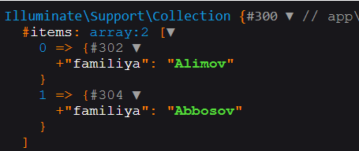
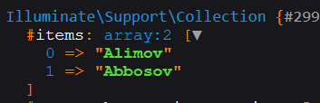
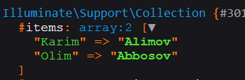
Query Builder (kolleksiya qaytarish)
Biror maydon uchun Illuminate\Support\Collection sinf turida qiymat qaytarish uchun select-get yoki pluck metodidan foydalanish mumkin. Select-get metodida obyektlar kolleksiyasi qaytariladi. Pluck metodida birinchi argument kolleksiya qiymati, ikkinchi argument esa kolleksiya kaliti sifatida qabul qilinadi.
// $talabalar = DB::table('talaba')->select('m1', 'm2 as m')->get();
$talabalar = DB::table('talaba')->select('familiya')->get();
foreach ($talabalar as $key => $talaba) {
echo "$key {$talaba->familiya}<br>";
}
$familiyalar = DB::table('talaba')->pluck('familiya');
foreach ($familiyalar as $key => $familiya) {
echo "$key $familiya<br>";
}
$familiyalar = DB::table('talaba')->pluck('familiya', 'ism');
foreach ($familiyalar as $key => $familiya) {
echo "$key $familiya<br>";
}

Slide 10
Query Builder. Natijalarni ajratish
chunk yoki chunkById metodlari orqali natijalarni N tadan ajratib biror ish amalga oshirish mumkin.
use Illuminate\Support\Collection;
use Illuminate\Support\Facades\DB;
DB::table('users')->orderBy('id')->chunk(100, function (Collection $users) {
foreach ($users as $user) {
// ...
}
// return false; // ishni to'xtatish
});

Slide 11
Query Builder. Natijalarni ajratish
chunk yoki chunkById metodlari orqali natijalarni N tadan ajratib biror ish amalga oshirish mumkin.
use Illuminate\Support\Collection;
use Illuminate\Support\Facades\DB;
DB::table('users')->where('active', false)
->chunkById(100, function (Collection $users) {
foreach ($users as $user) {
DB::table('users')
->where('id', $user->id)
->update(['active' => true]);
}
});

Slide 12
Lazy kolleksiyalar
lazy (lazyById, lazyByIdDesc) metodi chunk kabi ishlaydi faqat so'rovlarni amalga oshirishni ajratadi.
DB::table('talaba')->orderBy('id')->lazy()->each(function (object $talaba) {
var_dump($talaba->familiya);
});
DB::table('users')->where('active', false)
->lazyById(100)->each(function (object $user) {
DB::table('users')
->where('id', $user->id)
->update(['active' => true]);
});
select * from `talaba` order by `id` asc limit 1000 offset 0

Slide 13
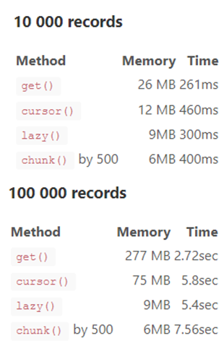
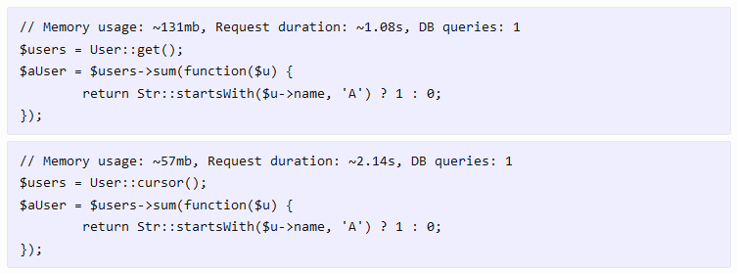
Metodlarni taqqoslash

Slide 14
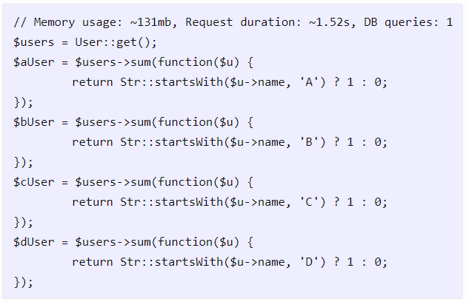
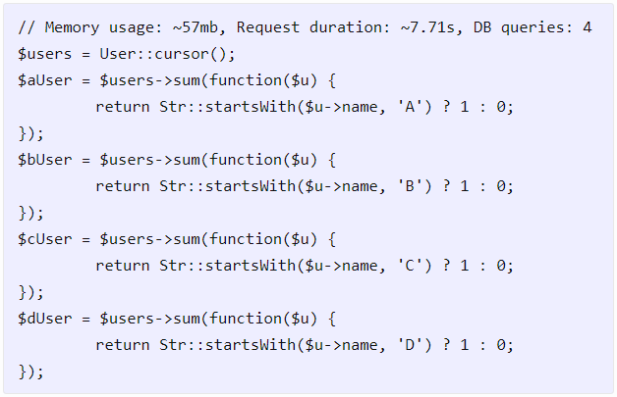
Metodlarni taqqoslash

Slide 15
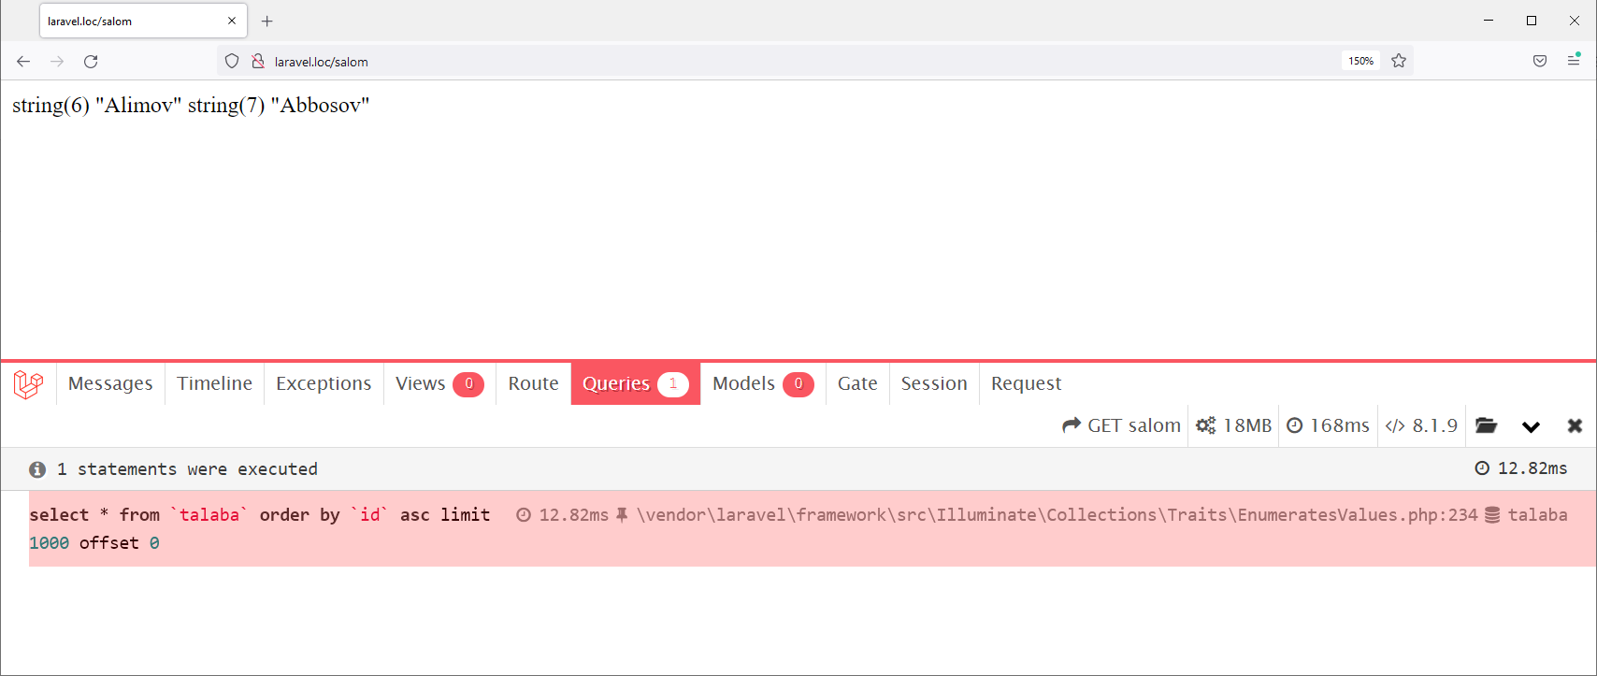
Laravel Debugbar
Qo'shimcha paket – Laravel Debugbar - https://github.com/barryvdh/laravel-debugbar
O'rnatish: composer require barryvdh/laravel-debugbar --dev
APP_DEBUG ning qiymati true bo'lganda ishlaydi.

Slide 16
Query Builder agregat funksiyalar
count, max, min, avg va sum agregat funksiyalarni ishlatish mumkin.
use Illuminate\Support\Facades\DB;
$users = DB::table('users')->count();
$price = DB::table('orders')->max('price');
$price = DB::table('orders')
->where('finalized', 1)
->avg('price');

Slide 17
Bog'lanishlar
$users = DB::table('users')
->join('contacts', 'users.id', '=', 'contacts.user_id')
->join('orders', 'users.id', '=', 'orders.user_id')
->select('users.*', 'contacts.phone', 'orders.price')
->get();
$users = DB::table('users')
->leftJoin('posts', 'users.id', '=', 'posts.user_id')
->get();
$users = DB::table('users')
->rightJoin('posts', 'users.id', '=', 'posts.user_id')
->get();

Slide 18
Query Builderda where metodi
where metodi so'rovdan qidirishni amalga oshirish uchun ishlatiladi.
Odatda 3ta argument zarur: maydon nomi, operator, qiymat. Operator sifatida berilganlar bazasi tizimi qo'llashi mumkin bo'lgan ixtiyoriy operator ishlatilishi mumkin.
$users = DB::table('users')
->where('votes', 100)->get();
$users = DB::table('users')
->where('votes', '>=', 100)
->get();
$users = DB::table('users')
->where('votes', '=', 100)
->where('age', '>', 35)
->get();
$users = DB::table('users')
->where('votes', '<>', 100)
->get();
$users = DB::table('users')
->where('name', 'like', 'T%')
->get();
$users = DB::table('users')->where([
['status', '=', '1'],
['subscribed', '<>', '1'],
])->get();

Slide 19
Query Builderda shart metodlari
orWhere metodi ikkita shartni or orqali birlashtirishni amalga oshiradi.
$users = DB::table('users')
->where('votes', '>', 100)
->orWhere('name', 'John')
->get();
whereIn – kolleksiya ichidalikka tekshiradi
$users = DB::table('users')
->whereIn('id', [1, 2, 3])
->get();
whereBetween – qiymat orasidalikka tekshiradi:
$users = DB::table('users')
->whereBetween('votes', [1, 100])
->get();
https://laravel.com/docs/10.x/queries#basic-where-clauses

Slide 20
Query Builderda shartni guruhlash
$users = DB::table('users')
->where('name', '=', 'John')
->where(function (Builder $query) {
$query->where('votes', '>', 100)
->orWhere('title', '=', 'Admin');
})
->get();
SQL: select * from users where name = 'John' and (votes > 100 or title = 'Admin')
$users = DB::table('users')
->where('votes', '>', 100)
->orWhere(function (Builder $query) {
$query->where('name', 'Abigail')
->where('votes', '>', 50);
})
->get();
SQL: select * from users where votes > 100 or (name = 'Abigail' and votes > 50)

Slide 21

Migration
database/migrations papkasida fayllarni yaratadi
Artisan buyrug'i orqali yaratiladi: php artisan make:migration create_talabalar_table

Slide 22
Migration
public function up(): void
{
Schema::create('talabalar', function (Blueprint $table) {
$table->id();
$table->string('familiya');
$table->string('ism');
$table->datetime('tugilgan_sana')->nullable();
$table->string('jinsi', 1)->default('M');
$table->timestamps();
});
}
public function down(): void
{
Schema::dropIfExists('talabalar');
}

Slide 23
Migration
Migratsiyani amalga oshirish uchun: php artisan migrate
Migratsiyani orqaga qaytarish: php artisan migrate:rollback
php artisan migrate:rollback --step=5
Barcha migratsiyalarni orqaga qaytarish: php artisan migrate:reset
Barcha migratsiyalarni orqaga qaytarish va boshidan ishga tushurish:
php artisan migrate:refresh
Barcha jadvallarni o'cherish va migratsiyani boshidan ishga tushurish:
php artisan migrate:fresh

Slide 24
Migratsiya uchun maydon turlari
Maydon turlari namunalari:
$table->bigIncrements('id');
$table->bigInteger('votes');
$table->boolean('confirmed');
$table->date('created_at');
$table->double('amount', 8, 2);
$table->decimal('amount', $precision = 8, $scale = 2);
$table->string('first_name', 50);
https://laravel.com/docs/10.x/migrations#available-column-types

Slide 25
Maydon modifikatorlari
Modifikator | Ta'rif
->comment('my comment') | Maydonga izoh qo'shish (MySQL/PostgreSQL).
->default($value) | Maydon uchun kelishuv bo'yicha qiymat joylab qo'yish
->nullable($value = true) | Maydonda NULL qiymatlarni yuklashga ruxsat
->unsigned() | INTEGER maydonlarga UNSIGNED atributini o'rnatadi (MySQL).
->useCurrent() | TIMESTAMP maydonlarga CURRENT_TIMESTAMP qiymatini kelishuv bo'yicha o'rnatish
->useCurrentOnUpdate() | TIMESTAMP maydonlarga CURRENT_TIMESTAMP qiymatini qator yangilanganda o'rnatish (MySQL).
->virtualAs($expression) | Virtual hosil qilinadigan maydon yaratish (MySQL).
https://laravel.com/docs/10.x/migrations#column-modifiers

Slide 26
Tashqi kalitlar
"posts" jadvalidagi maydonni "users" jadvali bilan ulash:
Schema::table('posts', function (Blueprint $table) {
$table->unsignedBigInteger('user_id');
$table->foreign('user_id')
->references('id')
->on('users');
});
Schema::table('posts', function (Blueprint $table) {
$table->foreignId('user_id')
->constrained()
->nullable();
});
Schema::table('posts', function (Blueprint $table) {
$table->foreignId('user_id')->constrained('users');
});
Schema::table('posts', function (Blueprint $table) {
$table->foreignId('user_id')
->constrained()
->onUpdate('cascade')
->onDelete('set null');
});

Slide 27
Indekslar
$table->primary('id'); | primary key qo'shish
$table->primary(['id', 'parent_id']); | Kompozit kalitlarni primary key sifatida qo'shish
$table->unique('email'); | Unikal maydon indeksini qo'shish
$table->index('state'); | Indeks qo'shish
$table->fullText('body'); | To'liq matnli index qo'shish (MySQL/PostgreSQL).
$table->fullText('body')->language('english'); | Ko'rsatilgan til uchun to'liq matnli index qo'shish (PostgreSQL).
$table->spatialIndex('location'); | Spatial index qo'shish (SQLite dan boshqa).

Slide 28
Database: Seeding
Ishga tushurish:
php artisan db:seed
php artisan db:seed --class=TalabaSeeder
php artisan migrate:fresh --seed
php artisan migrate:fresh --seed --seeder=TalabaSeeder
Yaratish: php artisan make:seeder TalabaSeeder
<?php namespace Database\Seeders; use Illuminate\Database\Seeder;
use Illuminate\Support\Facades\DB;
use Illuminate\Support\Str;
use Carbon\Carbon; class TalabaSeeder extends Seeder
{
public function run(): void
{
$date = Carbon::create(2000, 1, 1, 0, 0, 0);
DB::table('talabalar')->insert([
'familiya' => Str::random(10),
'ism' => Str::random(10),
'tugilgan_sana' => $date->addDays(random_int(1, 365)),
]);
}
}

Slide 29
Database: Seeding
Ishga tushurish:
php artisan db:seed
php artisan migrate:fresh --seed
DatabaseSeeder faylida:
public function run(): void
{
$this->call([
UserSeeder::class,
PostSeeder::class,
CommentSeeder::class,
]);
// \App\Models\User::factory()->count(50)->create();
}

Slide 30
Eloquent ORM
Object Relational Mapping (ORM) – obyektga yo'naltirilgan dasturlash va relyatsion berilganlar bazasi orasida "bog'lanish"ni amalga oshiruvchi texnologiya.
Model yaratish: php artisan make:model ModelNomi
app\Models papkasida yaratadi.
Kelishuv bo'yicha modelning nomi ko'plikdagi varianti – jadvalning nomi.
Flight – flights
AirTrafficController - air_traffic_controllers
O'zgartirish uchun modelda maxsus table xossasini o'rnatish kerak:
<?php
namespace App\Models;
use Illuminate\Database\Eloquent\Factories\HasFactory;
use Illuminate\Database\Eloquent\Model;
class Talaba extends Model
{
use HasFactory;
protected $table = 'talabalar';
}

Slide 31
Factory
Factory yaratish: php artisan make:factory TalabaFactory
database/factories papkasida fayl yaratadi.
class TalabaFactory extends Factory
{
protected $model = Talaba::class;
public function definition(): array
{
return [
'familiya' => "Alimov",
"ism" => 'karim',
'tugilgan_sana' => now()
];
}
}
Modelda:
protected static function newFactory(): Factory
{
return TalabaFactory::new();
}
class DatabaseSeeder extends Seeder
{
public function run(): void
{
Talaba::factory()->count(10)->create();
}
}
php artisan db:seed

Slide 32
Factory
class DatabaseSeeder extends Seeder
{
public function run(): void
{
Talaba::factory()->count(10)->create();
}
}
php artisan db:seed
Factory yaratish: php artisan make:factory TalabaFactory
database/factories papkasida fayl yaratadi.
class TalabaFactory extends Factory
{
protected $model = Talaba::class;
public function definition(): array
{
return [
'familiya' => $this->faker->name,
"ism" => fake()->unique()->numberBetween(1, 50),
'tugilgan_sana' => now()
//
];
}
}
https://fakerphp.github.io/

Slide 33
Model
Asosiy kalit o'rnatish (kelishuv bo'yicha id maydonidan oladi): protected $primaryKey = 'talaba_id';
Asosiy kalitlar autoincrement ko'rinishida bo'lishi shart emas. UUID (Universally Unique IDentifier) bo'lishi ham mumkin.
Migrationda: $table->uuid('id');
Modelda:
use Illuminate\Database\Eloquent\Concerns\HasUuids;
use Illuminate\Database\Eloquent\Model; class Article extends Model
{
use HasUuids;
// ...
}
Ishlatishda: $article = Article::create(['title' => 'Traveling to Europe']); $article->id; // "8f8e8478-9035-4d23-b9a7-62f4d2612ce5"

Slide 34
Modelni ishlatish
Modelni import qilib ishlatish mumkin.
use App\Models\Talaba;
...
foreach (Talaba::all() as $talaba) {
echo $talaba->familiya;
}
$talabalar = Talaba::where('active', 1)
->orderBy('familiya')
->take(10)
->get();
foreach ($talabalar as $talaba) {
echo $talaba->familiya;
}

Slide 35
Modelni ishlatish
Bitta model obyektini tanlash:
use App\Models\Flight;
// primary key bo'yicha obyekt olish
$flight = Flight::find(1);
// so'rov shartiga mos birinchi obyektni olish
$flight = Flight::where('active', 1)->first();
// so'rov shartiga mos birinchi obyektni olish
$flight = Flight::firstWhere('active', 1);
// primary key bo'yicha obyekt olish topa olmasa closure funksiya ishlaydi
$flight = Flight::findOr(1, function () {
// ...
});
// so'rov shartiga mos obyekt topilmasa closure funksiya ishlaydi
$flight = Flight::where('legs', '>', 3)->firstOr(function () {
// ...
});

Slide 36
Modelni ishlatish
Bitta model obyektini tanlashda topilmaslik xatosini tutib olish:
$flight = Flight::findOrFail(1);
$flight = Flight::where('legs', '>', 3)->firstOrFail();
Agar bunday obyektlar topilmasa Illuminate\Database\Eloquent\ModelNotFoundException xatoligi tutib olinadi. Xatolar uchun blade fayllarni resources/views/errors/404.blade.php manzilda joylashtirish mumkin:

Slide 37
Modelni olish yoki yaratish
// name bo'yicha qidirish va mavjud bo'lmasa yaratish va saqlash
$flight = Flight::firstOrCreate([
'name' => 'London to Paris'
]);
// name bo'yicha qidirish va mavjud bo'lmasa qo'shimcha maydonlar bilan yaratish va saqlash
$flight = Flight::firstOrCreate(
['name' => 'London to Paris'],
['delayed' => 1, 'arrival_time' => '11:30']
);
// name bo'yicha qidirish va mavjud bo'lmasa yaratish
$flight = Flight::firstOrNew([
'name' => 'London to Paris'
]);
// name bo'yicha qidirish va mavjud bo'lmasa qo'shimcha maydonlar bilan yaratish
$flight = Flight::firstOrNew(
['name' => 'Tokyo to Sydney'],
['delayed' => 1, 'arrival_time' => '11:30']
);
// firstOrNew metodi ishlatilganda bazada saqlash uchun save() metodidan foydalaniladi
$flight->save();

Slide 38
Yangi obyekt
Modelda yangi obyekt yaratish uchun new va save metodidan foydalanish mumkin, yoki create metodi orqali yaratish mumkin. Create (va/yoki update) metodlari ishlatilayotganda modelda guarded va/yoki fillable xossalari o'rnatilgan bo'lishi kerak.
public function store(Request $request): RedirectResponse
{
$flight = new Flight;
$flight->name = $request->name;
$flight->save();
$flight = Flight::create([
'name' => 'London to Paris',
]);
return redirect('/flights');
}
class Talaba extends Model
{
use HasFactory;
protected $table = 'talabalar';
// hech qaysi maydon himoyalanmagan
protected $guarded = [];
// faqat ko'rsatilgan maydonlargagina massiv ko'rinishida qiymat berish mumkin
protected $fillable = ['familiya', 'ism', 'tugilgan_sana'];
}

Slide 39
Obyektni yangilash
Model obyektini o'zgartirish uchun maydonlarga alohida qiymat berish va saqlash, yoki update metodi orqali massiv ko'rinishida maydonlarning yangi qiymatlarini berish mumkin.
$flight = Flight::find(1);
$flight->name = 'Paris to London';
$flight->save();
Flight::where('active', 1)
->where('destination', 'San Diego')
->update(['delayed' => 1]);

Slide 40
Obyektni o'chirish
O'chirish uchun obyektni topish va delete() metodidan, yoki model orqali destroy metodi mavjud.
$flight = Flight::find(1);
$flight->delete();
Flight::destroy(1);
Flight::destroy(1, 2, 3);
Flight::destroy([1, 2, 3]);
Flight::destroy(collect([1, 2, 3]));
Flight::where('active', 0)->delete();

Slide 41
Sohalar (scope)
Ko'p qaytariluvchi so'rovlarni to'plamini yaratish imkonini beradi.
class News extends Model
{
public function scopePopular(Builder $query): void
{
$query->where('votes', '>', 100);
} public function scopeActive(Builder $query): void
{
$query->where('active', 1);
}
public function scopeOfCategory(Builder $query, string $cat): void
{
$query->where('category', $cat);
}
}
Ishlatish:
$news = News::popular()->active()->orderBy('created_at')->get();
$news_sport = News::active()->ofCategory('sport')->orderBy('created_at')->get();

Slide 42
Aloqalar (relationships)
One-to-one: return $this->hasOne(Model, 'foreign_key', 'local_key');
One-to-many: return $this->hasMany(Model, 'foreign_key', 'local_key');
Inverse: return $this->belongsTo(Model, 'foreign_key', 'owner_key');
<?php
namespace App\Models;
use Illuminate\Database\Eloquent\Model;
use Illuminate\Database\Eloquent\Relations\HasMany;
class Post extends Model
{
public function comments(): HasMany
{
return $this->hasMany(Comment::class);
}
}
<?php
namespace App\Models;
use Illuminate\Database\Eloquent\Model;
use Illuminate\Database\Eloquent\Relations\BelongsTo;
class Comment extends Model
{
public function post(): BelongsTo
{
return $this->belongsTo(Post::class);
}
}

Slide 43
Aloqalar (relationships)
One-to-one: return $this->hasOne(Model, 'foreign_key', 'local_key');
One-to-many: return $this->hasMany(Model, 'foreign_key', 'local_key');
Inverse: return $this->belongsTo(Model, 'foreign_key', 'owner_key');
use App\Models\Post;
$comments = Post::find(1)->comments;
foreach ($comments as $comment) {
// ...
}
$comment = Post::find(1)->comments()
->where('title', 'foo')
->first();
use App\Models\Comment;
$comment = Comment::find(1);
return $comment->post->title;

Slide 44
Aloqalar
Many-to-many: return $this->belongsToMany(Model, 'table_name', 'fk_this', 'fk_model');
return $this->belongsToMany(Role::class, 'role_user', 'user_id', 'role_id');
<?php
namespace App\Models;
use Illuminate\Database\Eloquent\Model;
use Illuminate\Database\Eloquent\Relations\BelongsToMany;
class User extends Model
{
public function roles(): BelongsToMany
{
return $this->belongsToMany(Role::class);
}
}
$user = User::find(1);
foreach ($user->roles as $role) {
// ...
}
$roles = User::find(1)->roles()->orderBy('name')->get();

Slide 45
Aloqalar
Ko'pga-ko'p aloqada o'rtadagi jadvalning qo'shimcha maydonlarini olish:
return $this->belongsToMany(Model,…)->withPivot('maydon1', 'maydon2');
Modelda:
return $this->belongsToMany(Role::class)->withPivot('active', 'created_by');
Ishlatishda: $user = User::find(1);
foreach ($user->roles as $role) {
echo $role->pivot->created_at;
}

Slide 46
Eager Loading
Eloquent aloqalarni xossa kabi ishlatganda bog'liq modellar uchun "lazy loading" ishlaydi (N+1 so'rov muammosi). Bundan qutulish uchun with() metodi orqali aloqalarni yuklash zarur.
class Book extends Model
{
public function author(): BelongsTo
{
return $this->belongsTo(Author::class);
}
}
// ishlatishda
use App\Models\Book;
$books = Book::all();
foreach ($books as $book) {
echo $book->author->name;
}
$books = Book::with('author')->get();
foreach ($books as $book) {
echo $book->author->name;
}
// select * from books
// select * from authors where id in (1, 2, 3, 4, 5, ...)

Slide 47
Eager Loading
Eloquent aloqalarni xossa kabi ishlatganda bog'liq modellar uchun "lazy loading" ishlaydi (N+1 so'rov muammosi). Bundan qutulish uchun with() metodi orqali aloqalarni yuklash zarur.
// bir nechta aloqa
$books = Book::with(['author', 'publisher'])->get();
// ichma-ich aloqa
$books = Book::with('author.contacts')->get();
// bir nechta ichma-ich aloqa
$books = Book::with([
'author' => [
'contacts',
'publisher',
],
])->get();

Slide 48
Relation orqali saqlash
Create metodi orqali saqlash.
$post = Post::find(1);
$comment = $post->comments()->create([
'message' => 'A new comment.',
]);
$post->comments()->createMany([
['message' => 'A new comment.'],
['message' => 'Another new comment.'],
]);
Bitta bog'liq modelni saqlash.
use App\Models\Comment;
use App\Models\Post;
$comment = new Comment(['message' => 'A new comment.']);
$post = Post::find(1);
$post->comments()->save($comment);
Bir nechta bog'liq modellarni saqlash.
$post = Post::find(1);
$post->comments()->saveMany([
new Comment(['message' => 'A new comment.']),
new Comment(['message' => 'Another new comment.']),
]);
Rekursiv model va bog'liq modellarni saqlash.
$post = Post::find(1);
$post->comments[0]->message = 'Message';
$post->comments[0]->author->name = 'Author Name';
$post->push();

Slide 49
Relation orqali saqlash
BelongsTo relationda bog'lash uchun associate va bog'liqlikni o'chirish uchun dissociate metodi ishlatiladi:
use App\Models\Account;
$account = Account::find(10);
$user->account()->associate($account);
$user->save();
$user->account()->dissociate();
$user->save();

Slide 50
Relation orqali saqlash
Many To Many relationda bog'lash uchun attach va bog'liqlikni o'chirish uchun detach metodi ishlatiladi:
use App\Models\User;
$user = User::find(1);
$user->roles()->attach($roleId); $user->roles()->attach($roleId, ['expires' => $expires]); $user->roles()->detach($roleId); $user->roles()->detach(); $user->roles()->detach([1, 2, 3]); $user->roles()->attach([
1 => ['expires' => $expires],
2 => ['expires' => $expires],
]);

Slide 51
Relation orqali factory
hasMany relation uchun:
use App\Models\Guruh;
use App\Models\Talaba;
Guruh::factory()
->has(Talaba::factory()->count(3), 'talabalar')
->create();
belongsTo relation uchun:
Talaba::factory()
->count(3)
->for(Guruh::factory()->create())
->create();
$guruh = Guruh::find(2);
Talaba::factory()
->count(3)
->for($guruh)
->create();

Slide 52
Relation orqali factory
ManyToMany relation uchun has dan yoki hasAttached dan foydalanish mumkin:
Fan::factory()
->has(Guruh::factory()->count(2), 'guruhlar')
->count(2)->create();
Fan::factory()
->hasAttached(
Guruh::factory()->count(3),
['active' => true], # pivot jadval
'guruhlar' # relation nomi
)
->create();
Guruh::factory()
->has(Fan::factory()->count(2), 'fanlar')
->count(2)->create();

Slide 53
Relation orqali factory
ManyToMany relation uchun:
Guruh::factory()->count(5)->create();
Fan::factory()->count(3)->create();
$fanlar = Fan::all();
$guruhlar = Guruh::all();
$fanlar->each(function ($fan) use ($guruhlar) {
$fan->guruhlar()->attach($guruhlar->random(rand(1, 3))->pluck('id')->toArray());
});

Slide 54
Savollar?

